Slide 1
EXPLORING SUBMERGED HAZARDS: INNOVATION’s IN SUBMARINE ROCK AND MINE DETECTION RA2011026010082-SINDHU KALEESWARAN RA2011026010113-CHEREDDY SOWMYA SRI

Slide 2
TABLE OF CONTENTS:
Abstract
Introdution
Motivation
Innovation idea of the project
Scope of Project
Requirement Gathering
Literature Survey
Limitations Identified(from Literature)
References

Slide 3
Abstract:
This abstract highlights the significance of discriminating between these two underwater anomalies and explores the technological approaches employed in achieving accurate identification.
The detection and differentiation of submerged objects, such as submarine rocks and mines, play a pivotal role in maritime security and navigation safety.

Slide 4
Introduction: Submarine rocks, natural formations on the ocean floor, can sometimes exhibit characteristics that resemble underwater mines, which are deliberately placed explosive devices intended to target naval vessels. Accurate differentiation between these two types of underwater anomalies is critical for ensuring the safety of maritime activities, safeguarding naval assets, and maintaining navigational integrity.

Slide 5
Motivation:
The motivation for researching and developing techniques to differentiate between submarine rocks and underwater mines arises from the critical importance of maritime security, navigation safety, and the preservation of underwater ecosystems. It also promotes technological advancements that can have far-reaching impacts across military, navigational and environmental domains.

Slide 6
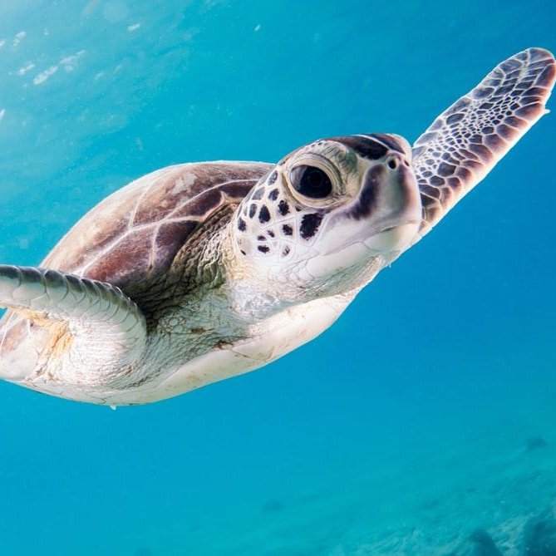
Innovation Idea:
Proposing an advanced approach for precise underwater differentiation between submarine rocks and mines by employing ensemble machine learning. Diverse underwater image data will be harnessed to train an ensemble of algorithms, comprising decision trees, random forests, support vector machines, and neural networks. The ensemble's collective decision-making will enhance detection accuracy by minimizing false identifications. This innovation ensures adaptability to varying underwater conditions through continuous learning.

Slide 7
Scope of Project:
By combining various ensemble methods and optimizing feature selection, these models can effectively handle complex relationships and class imbalances in the data. This approach enhances accuracy by aggregating diverse perspectives, allowing for real-time adaptation and scalability.
Integrating these ensemble models into existing underwater surveillance systems holds promise for enhancing maritime safety and environmental protection.

Slide 8
Requirements:
Functional Requirements:
The software requirements is the first step of an process.It lists the requirements of the particular software system.And these are some libraries used in this like sk-learn,pandas,Numpy,mat plot lib and sea born.Algorithms such as Logistic regression,KNN,
SVM,Naive Bayes,Decision tree,Random Forest,XGBoost.

Slide 9
Non-Functional Requirements:
Problem definition
Preparing data
Evaluating algorithms
Improving results
Prediction the result

Slide 10
Hardware Requirements:
Processor – i3 or higher
Hard Disk – 5 GB
Memory – 1GB RAM
Internet Connection
Software Requirements:
Windows 10 or higher
Colab – an online python interpreter
Python 3

Slide 11
Environmental Requirements:
OS - Windows, macOS, and Linux distributions GPU
Support Libraries and Frameworks
Documentation
Security
Scalability

Slide 12
Literature Survey:
S.No | Title | Techniques Discussed | Conclusion | Limitations
1 | “Machine Learning based Underwater Mine Detection”2023 7th ICICCS | One class of machine learning algorithms is XGBoost. Four varieties of machine learning algorithms are recognized. supervised, Unsupervised, Reinforcement, Semi Supervised. | This detection is done by a forecast model is built with the help of XGBoost algorithm, this forecast model yields more accuracy when contrasted with various classifier-based models because of its boosting nature. | XGBoost is a powerful algorithm, but it's often considered a "black box" model. It likely to have false predictions on mine detections. Moreover it doesnot check for cross-validation in case of over-fitting of data

Slide 13
2 | “Comprehensive Underwater Object Tracking Benchmark Dataset and Underwater Image Enhancement With GAN” IEEE JOURNAL OF OCEANIC ENGINEERING, JANUARY 2022 | An efficient GAN model is developed to improve the performance of existing trackers on distorted underwater data by efficiently translating the distorted data to their non-distorted/enhanced or clear underwater versions. | Analysis shows that correcting the underwater distortions by translating the visual data to an enhanced/clear domain using our model significantly improves tracking accuracy in underwater environments | The performance of state-of-the-art object tracking algorithms was shown to degrade considerably when tested on underwater environments as opposed to the open-air environments, due to the inherent distortions that affect the quality of Underwater Visual data.
3 | “Autonomous Underwater Environment Perceiving and Modeling: An Experimental Campaign With FeelHippo AUV for Forward Looking Sonar-Based Automatic Target Recognition and Data Association” IEEE JOURNAL OF OCEANIC ENGINEERING, APRIL 2023 | The SSD model has been trained using RMSProp with batch sizes of 24, whereas Mask R-CNN has exploited stochastic gradient descent with momentum with batch sizes of 1. | It is an extension of [18] and presents an experimental campaign concerning a CNN-based ATR and world modeling architecture for AUVs with FLS acoustical frames. | The outcome, with an average distance error of 0.73 meters, may not provide valid argument for the correctness.

Slide 14
4 | “Underwater object detection: architectures and algorithms – a comprehensive review”12 March 2022 | These aforementioned algorithms mainly employ CNN,YOLO and RCNN | Multiple subproblems in underwater object detection algorithms have also been comprehensively compared and reviewed. Also, deep learning-based underwater object detection algorithms, their architectures, and issues have been summarized. | However, not much of the work and research has been carried out in the area of underwater object detection using YOLO. These algorithms are not suitable for real-time underwater object detection.
5 | “Validation of Targets in Sonar Imagery Using Multispectral Analysis” IEEE JOURNAL OF OCEANIC ENGINEERING, OCTOBER 2022 | The JFT approach is based on the expected diversity in the reflection intensity of pixels associated with targets, compared to those associated with the background. In contrast, the JDRT method validates targets based on the difference in the distribution of pixels. | incorporation of the proposed validation approach within the sonar detection scheme yields a favorable tradeoff between the FAR and the detection rate. | Still, these experiments were not performed at sea, where the frequency-selective acoustic channel may distort the observa- tions.

Slide 15
6 | “Prediction of Rock and Mineral from Sound Navigation and Ranging Waves using Artificial Intelligence Techniques” Proceedings of the ICAISS-2022 | Simple Machine learning models from Logistic Regression to complex deep learning models such as LSTM and CNN models. | In this approach, PCA and t-SNE are employed to extract features. | It doesnot check for cross-validation in case of over-fitting of data.
7 | “Bathymetric Reconstruction From Sidescan Sonar With Deep Neural Networks” IEEE JOURNAL OF OCEANIC ENGINEERING,APRIL 2023 | CNN Architecture generates independent depth | A novel approach to reconstruct high-resolution bathymetry from sidescan data using a neural network is presented. | Several reasons could cause inaccurate sparse depth measurement like errors from the altimeter sensor, affecting the quality of reconstructed bathymetry. Not only the quality of the sparse depth but also the quantity affect the prediction accuracy.

Slide 16
8 | “Rock/ Mine Classification Using Supervised Machine Learning Algorithms” 2023 International Conference on IITCEE | Classification algorithm such as Light Gra- dient Boosting classifier, Random Forest classifier, and logistic to distin- guishing objects in submarine acoustics via resources sendSend message Checking who can access file | Among three algorithms, light gradient boosting achieves greater validation accuracy of 95%, logistic regression algorithm reaches less execution time of 0.015 seconds. | Could be better optimized for accurate results.
9 | “Side Scan Sonar Image Resolution and Automatic Object Detection, Classification and Identification” from IEEE Xplore | Probabilistic Neural Network (PNN) is used for final classification. As features for this classification process they use currently primarily some scoring values, which are generated by the false alarm reduction algorithms. | The results of the tests carried out with two algorithms for the reduction of false positives did not give totally different results for high resolution SAS and conventional SSS data. | Achieving high resolution and high area coverage simultaneously with a conventional SSS is rather difficult and a fundamental limitation of theses systems

Slide 17
10 | “Underwater Mine Detection and Classification in Sonar Imagery”2021 Journal of Mdpi | Deep convolutional neural networks were used to classify underwater targets in synthetic-aperture sonar (SAS) imagery. | Sonar images are complicated to analyse due to speckle noise and environmental conditions causing spurious shadows, sidelobe effects and multipath return. | Uses convolutional neural networks for location based on cross-validation. Manual setting of parameters is not required.
11 | “Prediction of Underwater Sonar Targets”July 2022 International Journal of Advanced Research in Computer and Communication Engineering | The Training Data trains the ML model (using different algorithms – LDA : Linear Discriminant analysis, SVM : Support Vector Machine, KNN : k-nearest neighbours, CART : Classification and Regression Trees, NB : Naive Bayes classifiers) and the Testing Data is used to evaluate the accuracy of the model | SVM model gives a better accuracy of approx. 93 % compared to the KNN model which gives approx. 88%. | The only dataset available for carrying out this project is not real world SONAR-data.

Slide 18
12 | “RDNN for classification and prediction of Rock/Mine in underwater acoustics” | SVM and NN algorithms were applied to distinguish sonar data.Utilized PCA and standalone architecture to integrate Back Propagation Neural Network for the categorization of two datasets (sonar and ionosphere datasets) in bagging ensemble architecture | Rock/mine detection neural network approach reveals enhanced outcomes by achieving mean accuracy of 100% with 0% SD using k-fold evaluation | RNNs require high-quality data for training. If the sonar data contains noise or artifacts, it can negatively impact the model's performance.
13 | “Classification of SONAR Targets Using Advanced Neural Classifiers”2017 International Journal of Pure and Applied Mathematics | Extreme learning machine is high speed learning neural network with single-hidden layer. ELM, the least square method is used for determining the output weight. | So efficiency of both networks is compared. The testing efficiency of MCNN and ELM are 87.5% and 84 % respectively. | MCNNs are highly data-dependent and prone to over-fitting and ELMs are not adaptive models. Therefore using these algorithms are not optimizable

Slide 19
14 | “Research on Classification and Recognition of Underwater Targets Based on Spark’s Decision Tree Technology” from IEEE Xplore | The decision tree algorithm uses the corresponding branching strategy from the top to the bottom to select the best branch attribute, and then divides the original data set according to the attribute. Spark also stores the intermediate data on the hard disk during MapReduce calculations. | This paper proposes a decision tree classification algorithm based on Spark. It makes good use of the memory-based distributed parallel processing capabilities of the Spark Big Data platform | All transformation operations are deferred, and they are not actuallyexecuted immediately. Only after the action operation iscompleted, it will actually trigger the previous transformationoperations.
15 | “Decision Tree-Based Adaptive Modulation for Underwater Acoustic Communications” from IEEE Xplore | A decision tree is trained to forecast the BER of the PSK signals based on estimates of channel delay and Doppler spread and the received SNR. | Results demonstrated that the decision tree predicted the BER fairly accurately. | Underwater channels are highly variable, influenced by factors like water temperature, salinity, and movement. This variability can make it challenging to adapt modulation schemes effectively in real-time.

Slide 20
16 | “A-KNN: An adaptive method for constructing high-resolution ocean models” from IEEE Xplore | This adopts the KNN regression method to refine the original dataset with a considerable interval, and the purpose is to interpolate the dataset into an evenly distributed dataset at intervals of 1 meter | The k-nearest neighbor regression model trained using the method proposed in this paper dramatically improves the vertical resolution of the data. | Due to the high cost of underwater nodes and related protective devices, wecannot solve the problem by increasing the amount of sparsity deployment of underwater nodes
17 | “Classification of Underwater Acoustic Signals Using Multi-Classifiers”Proceedings of 2018 15th International BCAST | K nearest neighbour,Support vector machine, Naïve Bayesian approach and artificial neural networks are used | Implemented multiple classification based identification techniques to classify underwater acoustic signals under controlled noise environment. The noise parameters for each type of classifiers were kept same. | some hybrid approaches can be deployed to getmore efficient results. Combination of Classifiers instead ofsingle one along with the denoising approach in preprocessingphase can provide much better results.

Slide 21
Objective:
The objective of this project is to develop and implement cutting-edge technologies and methods for the detection and mitigation of submerged hazards, specifically focusing on submarine rocks and mines.It also enhance the safety of naval vessels, submarines, and commercial ships by providing advanced detection capabilities for submerged hazards. Combines data from various sensors, including sonar, and imaging, to create comprehensive and reliable hazard detection systems.Achieve high accuracy in detecting and classifying underwater objects to minimize false alarms and ensure precise identification.

Slide 22
Problem Statement:
The maritime industry faces significant challenges in safeguarding vessels and underwater infrastructure.Current detection technologies are often limited in their accuracy, coverage, and cost-effectiveness, leading to increased risks, accidents, and operational inefficiencies. There is an urgent need to develop advanced and integrated detection solutions that can differentiate between submarine rocks and mines, providing real-time, reliable, and cost-efficient detection to enhance maritime safety, navigation, and environmental protection.

Slide 23
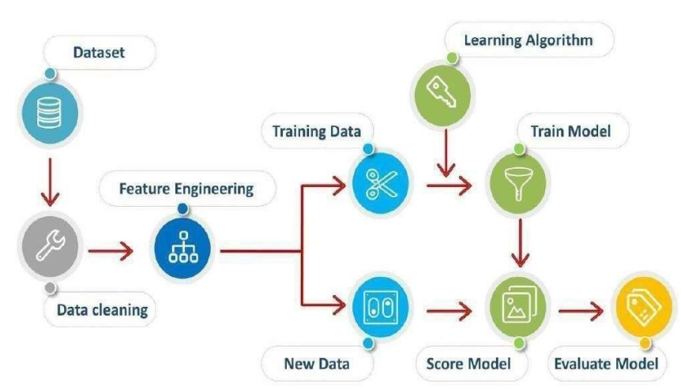
Architecture Diagram:

Slide 24
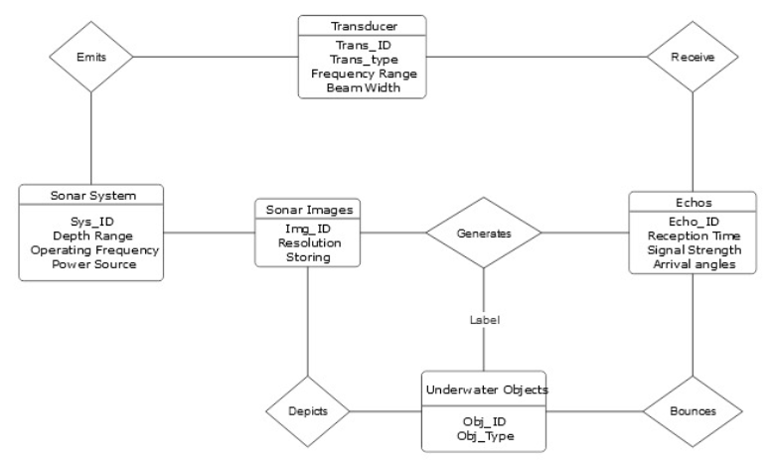
ER Diagram:

Slide 25
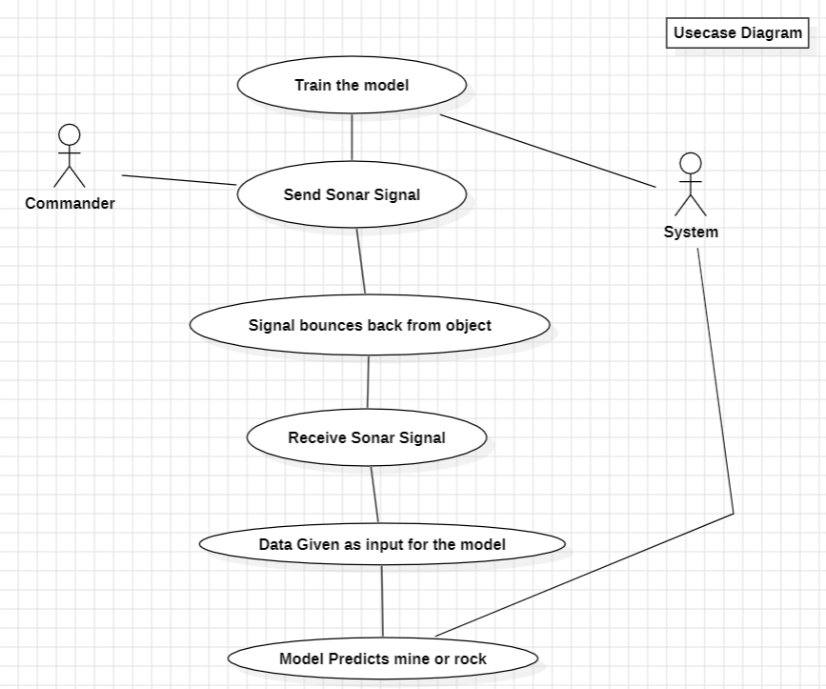
Usecase Diagram:

Slide 26
Modules Description:
a) Sonar System:
A sonar system typically starts with a transducer, which is a device that emits sound waves into the water. These sound waves are often in the form of high-frequency acoustic pulses. Underwater sonar systems use acoustic waves to capture images of underwater environments by emitting sound pulses, receiving echoes, and processing the data to create images. When the sound waves encounter an object, they bounce back as echoes. These echoes are received by the same transducer or another receiving transducer. Additionally, they collect numerical data on mines and rocks based on the acoustic back-scatter of sound waves.

Slide 27
b) Data Collection:
For the collection of numerical data, sonar systems emit acoustic signals into the water and measure the time it takes for these signals to travel to objects and return as echoes.This echoed data provides crucial information about distances to underwater objects and their acoustic characteristics. These data values are recorded at 60 different angles for 208 objects.Simultaneously, sonar systems are capable of collecting images of the underwater environment. We use side-scan sonar to create detailed two-dimensional images of the seafloor and any objects or structures on it. The intensity of echoes is used to create grayscale images, where brighter regions correspond to stronger echoes.

Slide 28
c) Preprocessing:
The sonar image data are divided into training, testing and validation batches. We have a total of 7 batches with 4 batches in training, 2 batches in validation and 1 batch for testing.As of sonar dataset, 80% of the data for training and remaining 20% for testing the prediction model.

Slide 29
d) Feature Extraction&classification of algorithms:
Now implementing Conv2D deep model, firstly we create an empty sequential model. Giving 256x256x3 image as input, we add 2D convolutional layer to the model with 16 filters and each of these having a 3x3 kernel with stride value 1. ReLu activation function is used in this case to tackle vanishing gradient problem. Then we add a 2D max-pooling layer to the sequential model. We repeat the steps again with lower number of filters for 3 iterations to capture high level feature and manage computational complexity. Then flattering out the model, we use dense function to reduce to 256 layers using ReLu activation function. Doing the same for the next dense layer, we use sigmoid for binary classification of whether the image belongs to mine or rock classification.

Slide 30
As for sonar data, we use ensemble techniques to observe the best performing algorithms out of all the algorithms. It is observed that logistic regression performs better than any other algorithm. Even after scaling, scaled logistic regression has the better performance. Thus, opting for logistic model, by applying threshold which is also enhanced with regularization techniques to prevent overfitting. Once the training is done, now the model is ready to predict the new data by estimate probabilities and classify examples into one of the two possible outcomes i.e., the object is rock or mine.

Slide 31
e) Training and testing:
Training and testing for submarine rock and mine detection involves data being split into be 70% for training, 10% for validation, and 20% for testing,selecting models consider ensemble methods like Random Forests or XGBoosting for improved accuracy,train rain the selected models on the training data using the ground truth labels,model evaluation assess the models' performance in terms of false positives and false negatives, which are critical in mine detection applications,fine-tuning refines the models based on the expected results.

Slide 32
In testing it has several steps like test data preparation it uses a separate, previously unseen test dataset that was not used during training or validation,model testing records the model predictions and compare them to the ground truth labels for evaluation,performance evaluation analyze the confusion matrix.

Slide 33
f) User interface:
Designing a user interface for submarine rock and mine detection is a critical aspect of the overall system.To effectively monitor and control the detection process the UI should provide operators with the necessary tools and information. Here, to detect rock and mine, a user-friendly interface has been developed using Streamlit. This UI serves as an intuitive platform for interacting with a machine learning model designed to distinguish between rocks and mines in underwater sonar data. Users can upload sonar images or data samples, and the model will provide real-time predictions, revealing whether the object in question is a rock or a mine.

Slide 34
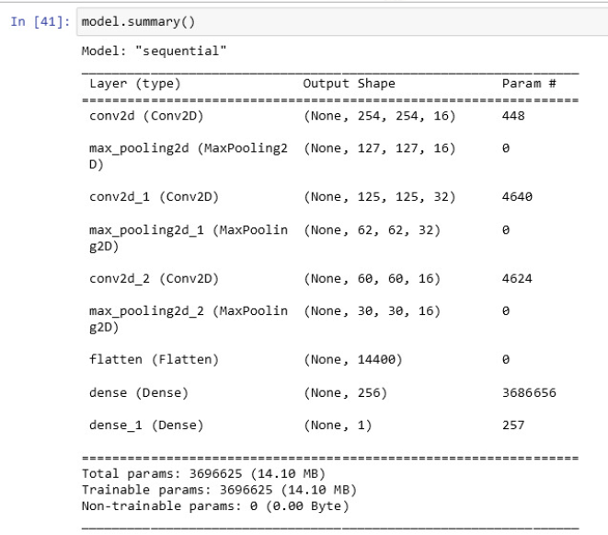
Coding&Implementation:

Slide 35
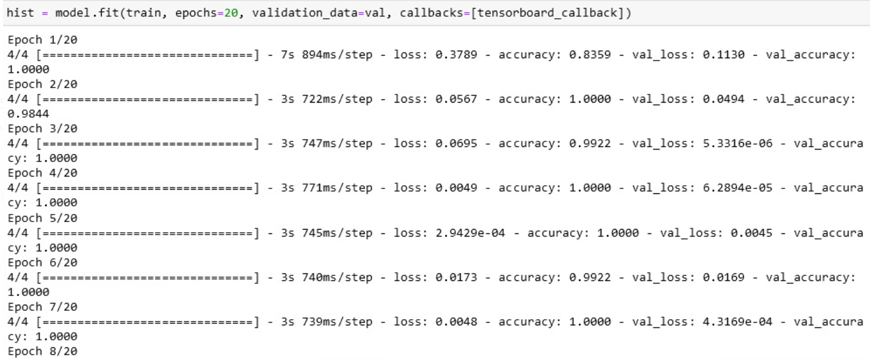

Slide 36
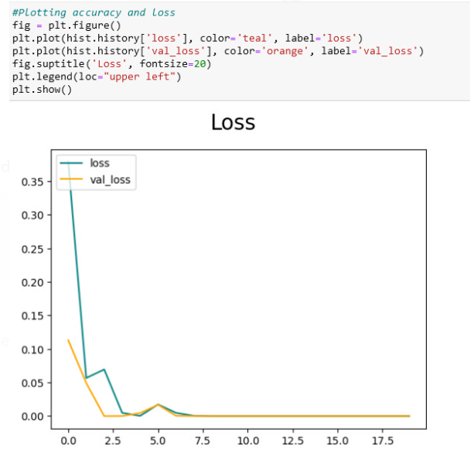
Model Loss:

Slide 37
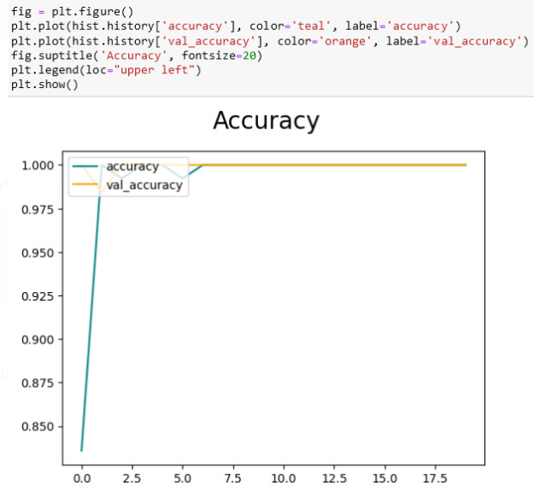
Model Accuracy:

Slide 38
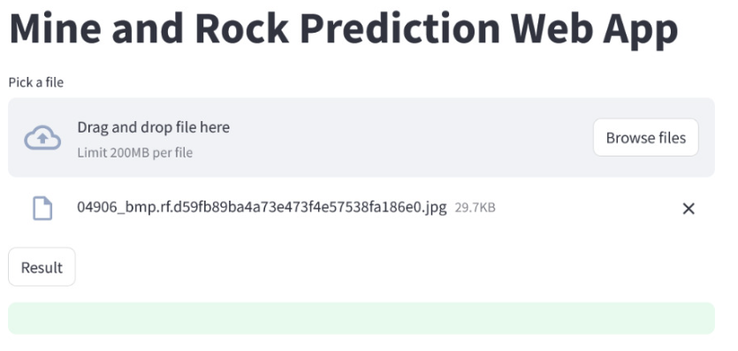
User interface:

Slide 39
Results:
1) K-Nearest Neighbour:
KNN is a simple yet effective algorithm that can be used for object classification when you have a labeled dataset of sensor data and corresponding labels.It is showed from the output results the accuracy for normal and scaled(see table 1).And the output values is given below.
Best: 0.879779 using {'n_neighbors': 1}
Table 1:Classification of KNN
Model | Mean | Std
KNN | 0.758456 | 0.105791
Scaled KNN | 0.837500 | 0.102055

Slide 40
2) Support Vector Machine:
In the second set of experiments,it is noted from the results that SVM works efficiently with polynomial kernal for both submarine rock and mine(see table 2)
Best: 0.873162 using {'C': 1.5, 'kernel': 'rbf’}
Table 2:Classification of svm
Model | Mean | Std
SVM | 0.601471 | 0.160777
Scaled SVM | 0.855147 | 0.091620

Slide 41
3) Decision tree:
In the third set of experiments,it is noted from the results that decision tree works accurately for the classification of submarine rock and mine(see table 3)
Table 3:Classification of Decision tree
Model | Mean | Std
DT | 0.718382 | 0.092559
Scaled DT | 0.681250 | 0.103413

Slide 42
4) Logistic Regression:
In the fourth set of experiments,the results are provided below(see table 4)
Table 4:Classification of LR
Model | Mean | Std
LR | 0.770956 | 0.058802
Scaled LR | 0.818750 | 0.066706

Slide 43
5) Image results:
In image dataset it contain images for both submarine rock and mine.Based on the image model will predict whether it is rock or mine(see table 5).The output results for submarine rock and mine detection is shown(see figure 1 and 2)It gives result with accuracy 100%.
Table 5:Output results
Precision | 1.0
Result | 1.0
Accuracy | 1.0

Slide 44

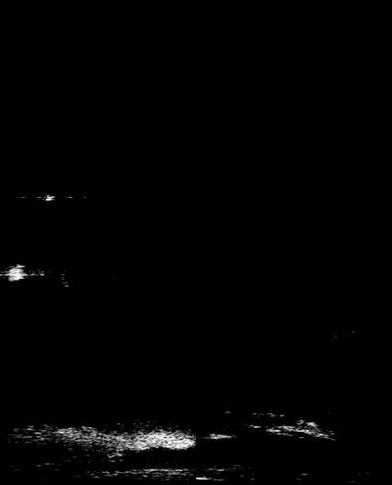
Figure 1:Submarine rock

Slide 45
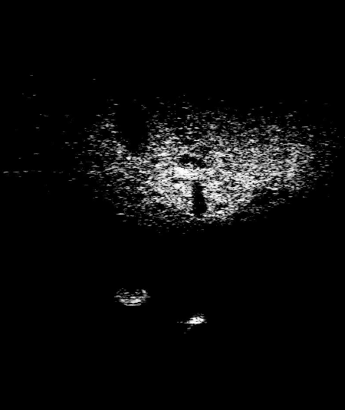
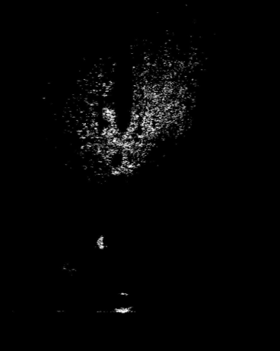
Figure 2:Mine

Slide 46
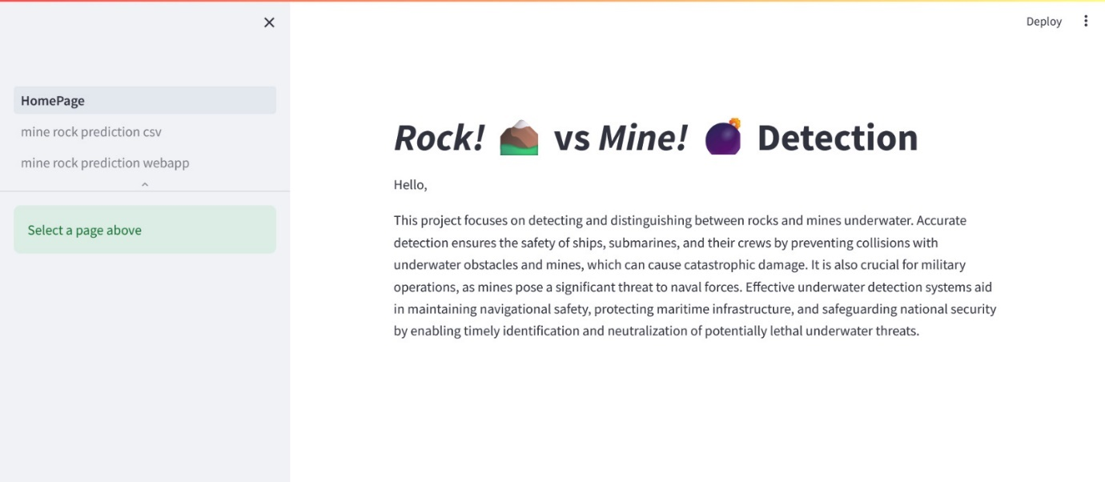
Output Screenshots:

Slide 47
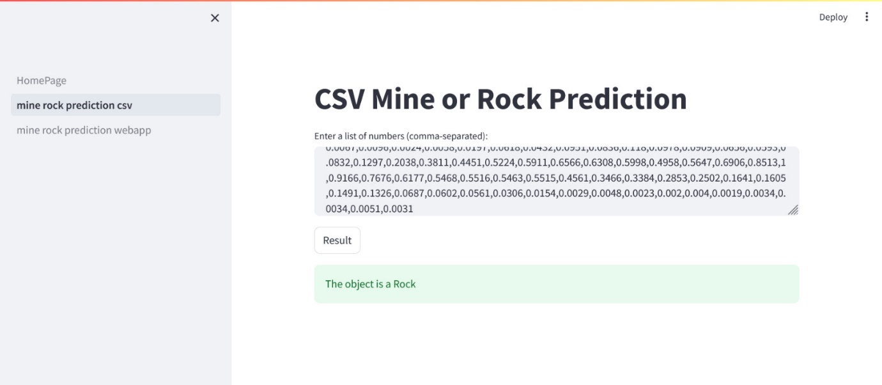

Slide 48
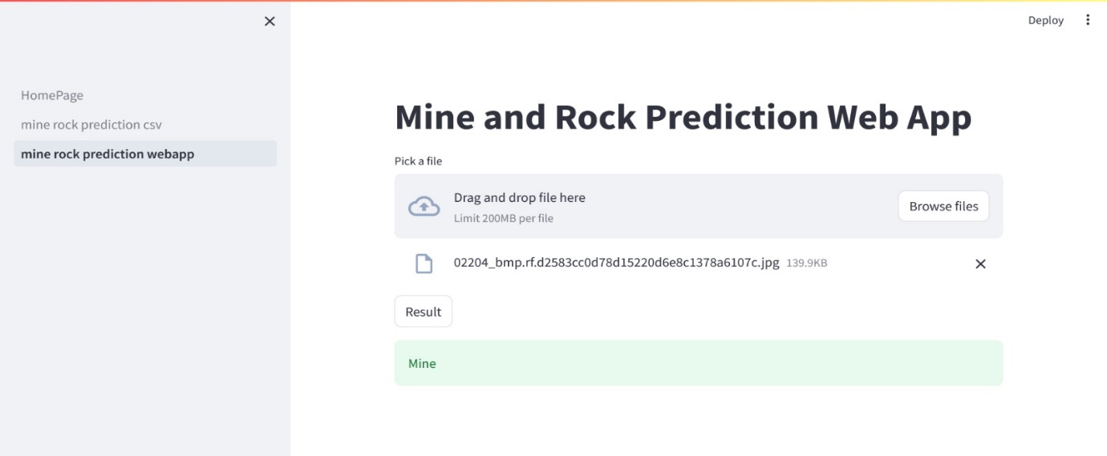

Slide 49
References:
1. D. P. Williams, “The Mondrian detection algorithm for sonar imagery,”IEEE Trans. Geosci. Remote Sens., vol. 56, no. 2, pp. 1091–1102,Feb. 2018.
2. Shantanu, Aman Saraf, Atharv Tiwari, Mukesh Kumar and S Manonmani, "Underwater Mines Detection using Neural Network", INTERNATIONAL JOURNAL OF ENGINEERING RESEARCH & TECHNOLOGY (IJERT), vol. 09, no. 04, April 2020 A 3. Review of Underwater Mine Detection and Classification in Sonar Imagery", Stanisław Hożyń ORCiD0000-0003-1422-0330.
4. S. Khaledi, H. Mann, J. Perkovich and S. Zayed, "Design of an underwater mine detection system", 2014 Systems and Information Engineering Design Symposium (SIEDS), pp. 78-83, 2014.
5. Guy Gubnitsky , Asaf Giladi, and Roee Diamant, “Validation of Targets in Sonar Imagery Using Multispectral Analysis”, IEEE JOURNAL OF OCEANIC ENGINEERING, VOL. 47, NO. 4, OCTOBER 2022

Slide 50
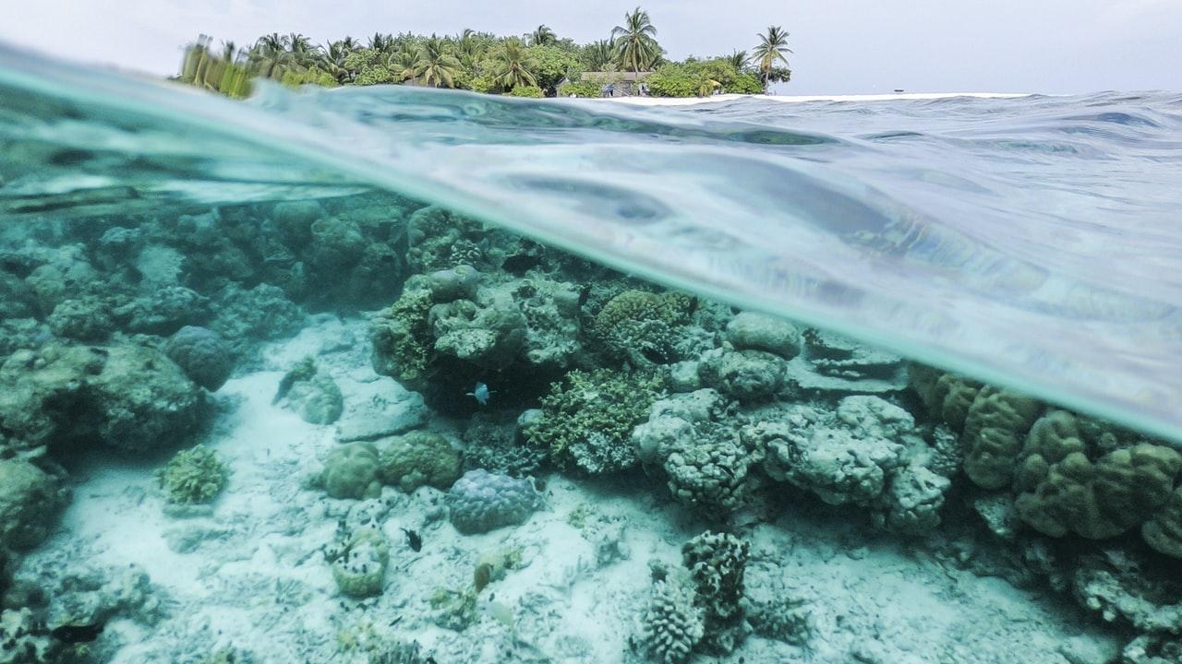
THANK YOU

